Slide 1

Employee payroll Management
System
GROUP - 7
233 Java Batch

Slide 2

Our Team
Rishu Kumar 2580201
Saurabh Gupta 2570125
Shubhangi Kailas Ravate 2579670
Sinchana J 2579642
Sk Md Akib 2579356
Solleti Nitish Reddy 2580309
Surabhi M Y 2579990

Slide 3
Contents
INTRODUCTION
OBJECTIVE
TOOLS & LANGUAGES
FEATURES OF EMPLOYEE PAYROLL MANAGEMENT SYSTEM
ADVANTAGES
APP FLOW
E-R DIAGRAM
SCREENSHOTS OF OUTPUT AND DETAILS
CONCLUSION

Slide 4
Introduction
Employee payroll management system is a java application that manages and keeps track of employees in the different departments.
It aims to replace manual systems, reducing errors and enhancing efficiency.
Offers scalability to accommodate the growing needs of the organization, making it a sustainable solution for payroll management.

Slide 5
objective
Primary Objective:
Create a practical, efficient system operable by all employees, emphasizing accuracy, timeliness, and comprehensiveness.
Key Objectives:
User-Friendly Interface
Comprehensive Record-Keeping
Scalability
Security and Data Privacy
Efficient Workflow
Adaptability to Modern Work Environments

Slide 6
Tools & Languages
Front End
Visual Studio
Angular
HTML
CSS
BOOTSTRAP
Back End
Spring Tool Suite
MySQL
Spring Data JPA
Postman

Slide 7
Features of Employee Payroll Management System
admin
add employees.
add salary for employees.
add leaves for employees.
schedule work to employees.
add attendance to employees.
employee
view and edit their profile.
view their approved leaves.
view their attendance.
view their assigned work details.
view and download their salary slips.

Slide 8
Advantages
Helps the employee easy way to access their data.
The information related to employee can be added , edited, removed easily.
Store the end-to-end data of the employees
Provides transparency in salary calculations, contributing to employee trust and satisfaction

Slide 9
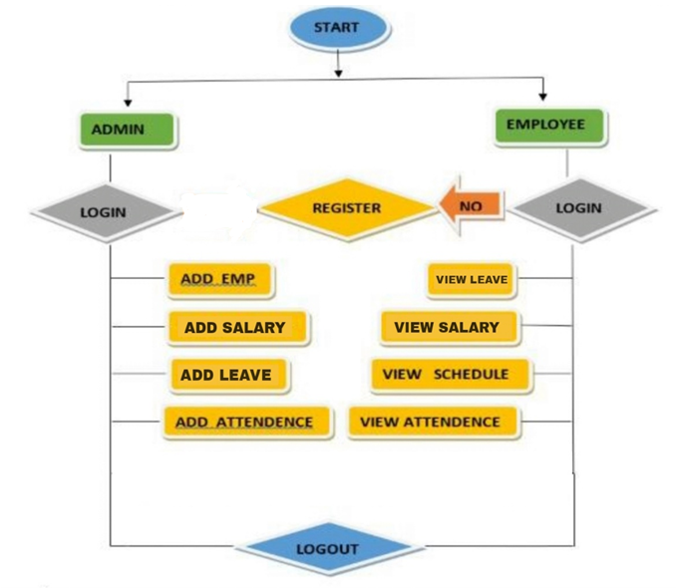
AppLication Flow

Slide 10
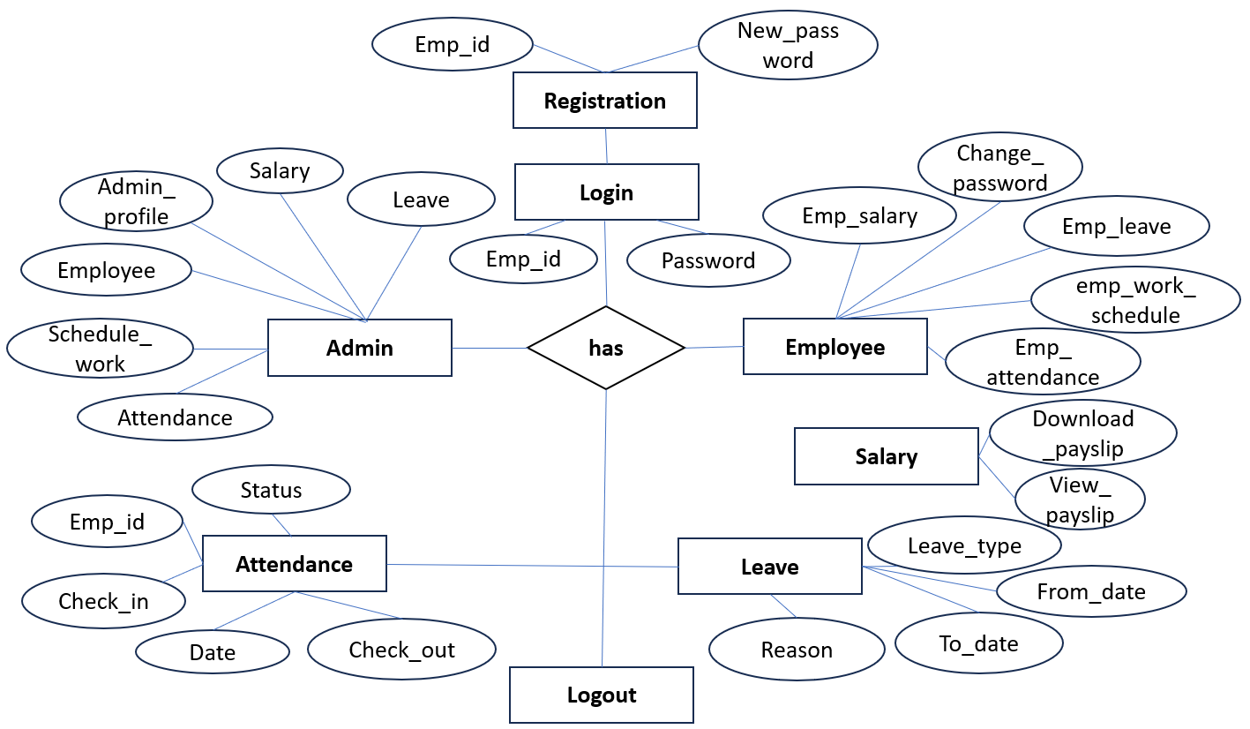
E-R Diagram:

Slide 11
Screenshots Of Output and Details

Slide 12
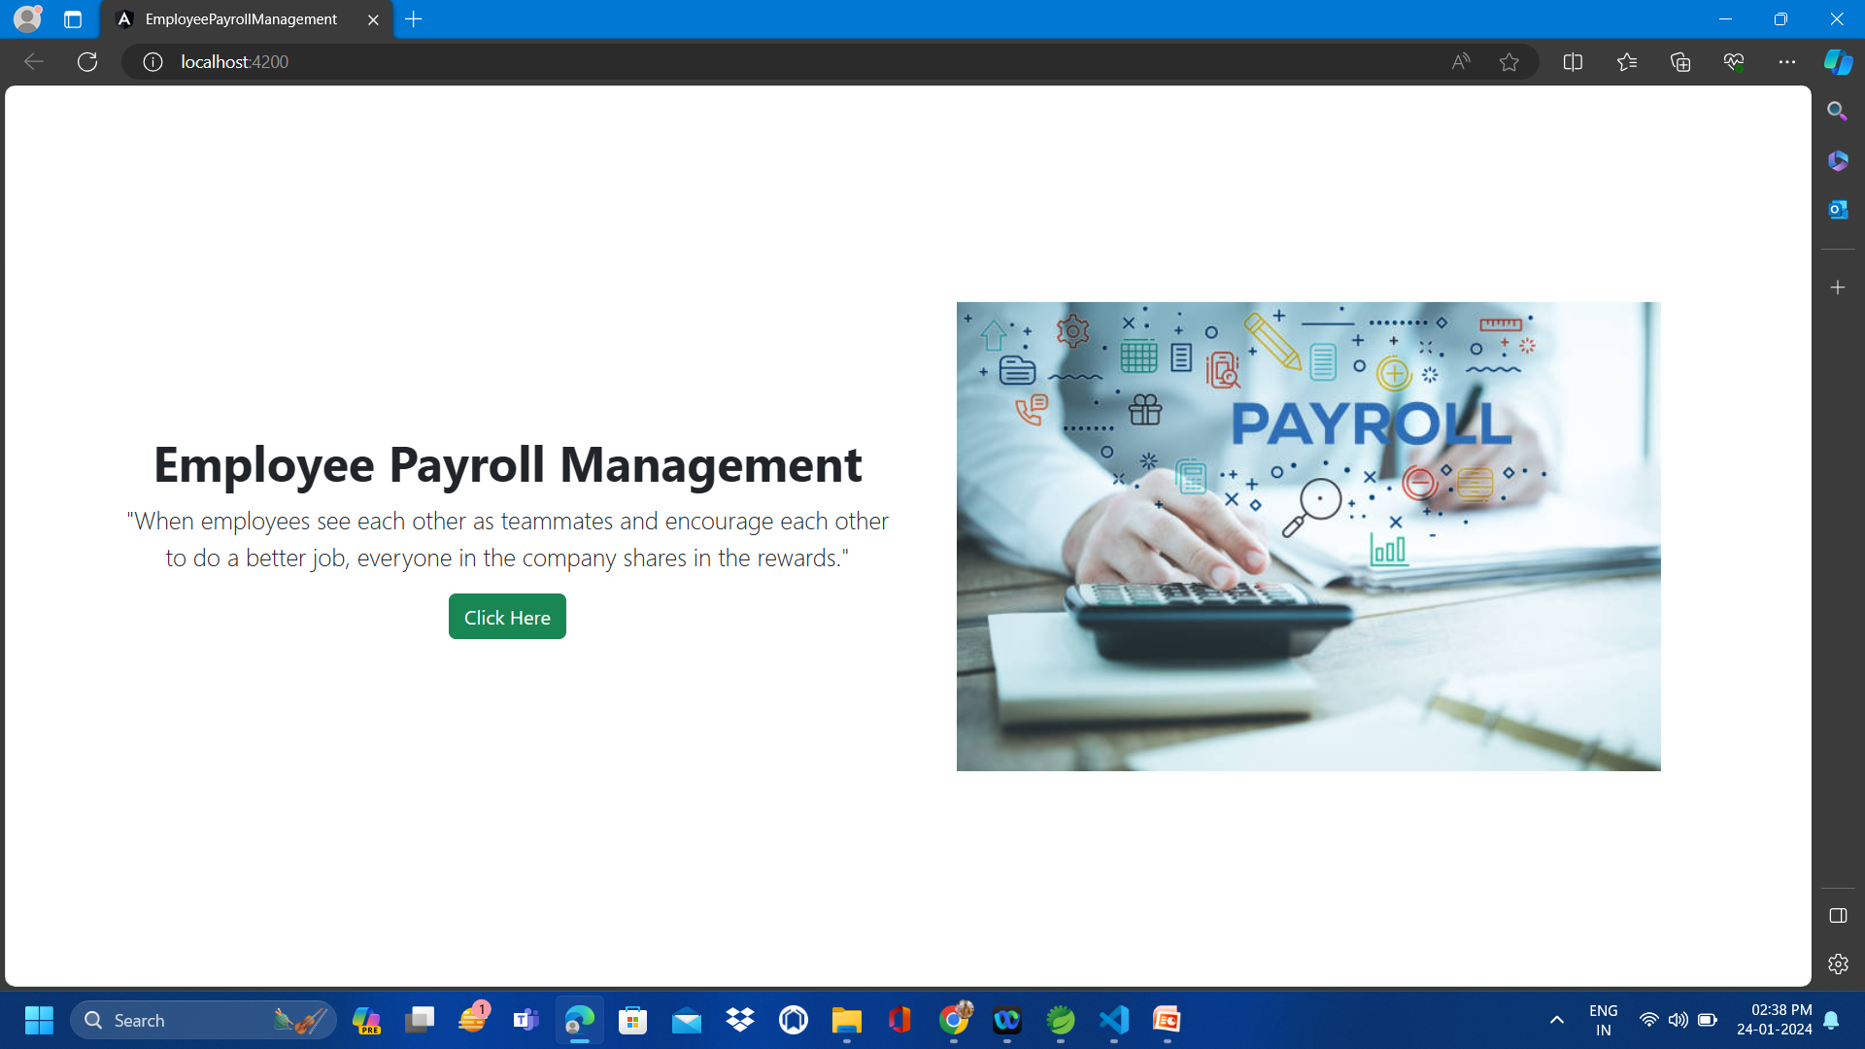
Home Page:

Slide 13
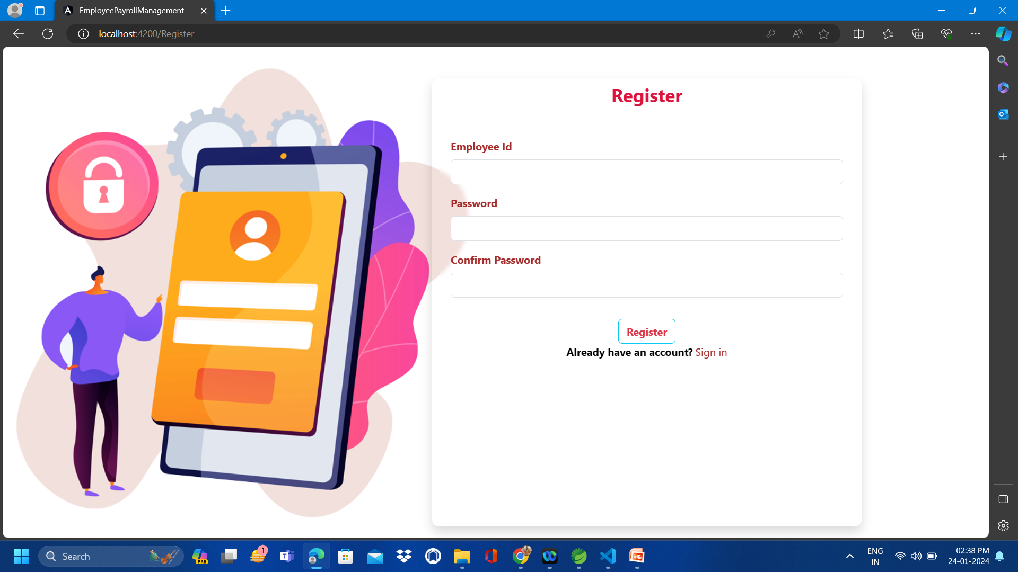
Register Page:

Slide 14
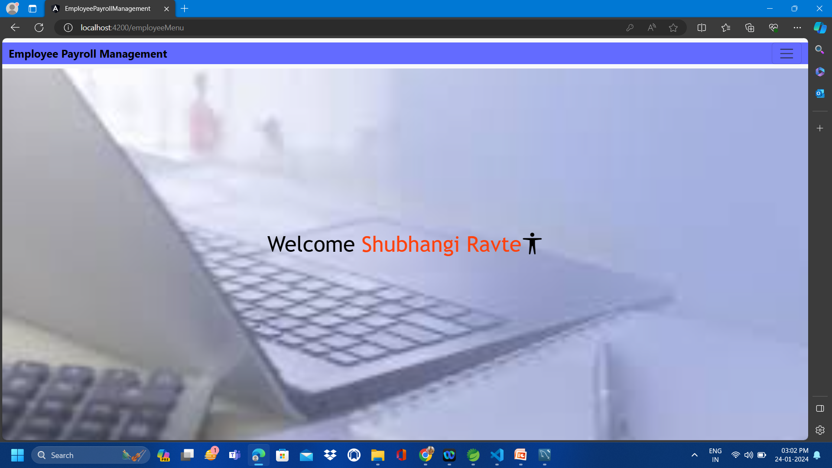
Welcome Page:

Slide 15
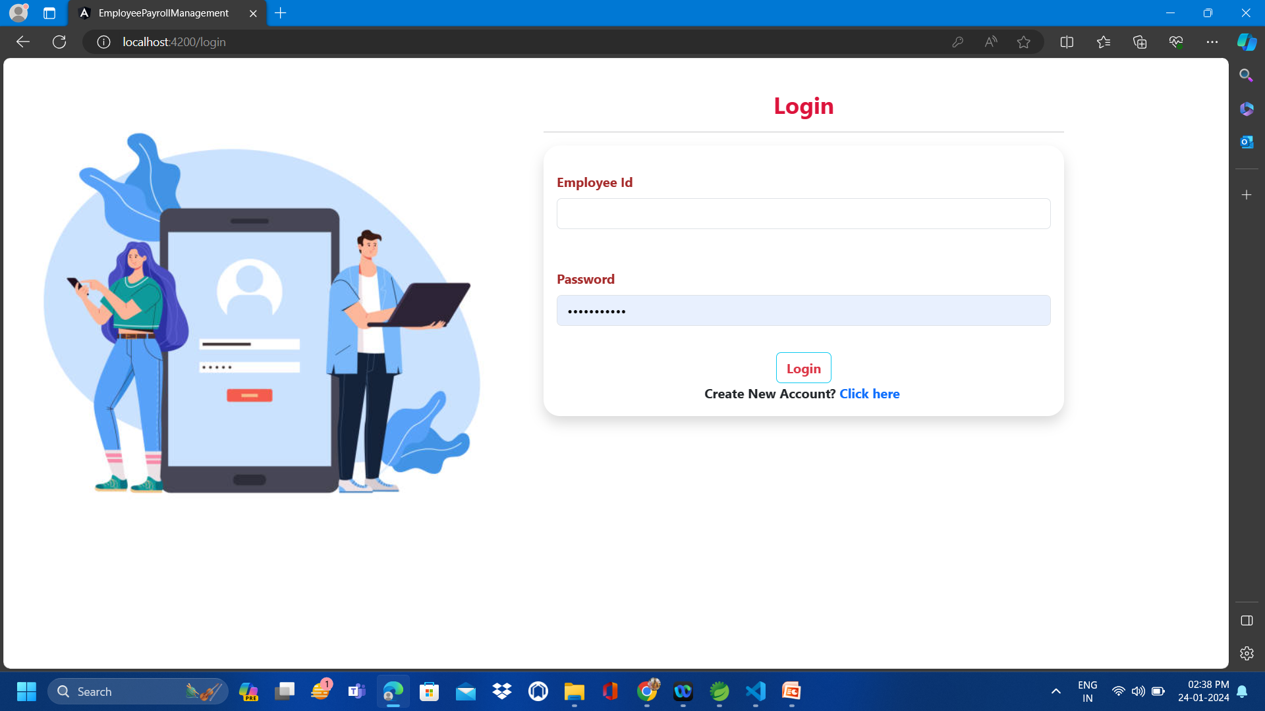
Login Page:

Slide 16
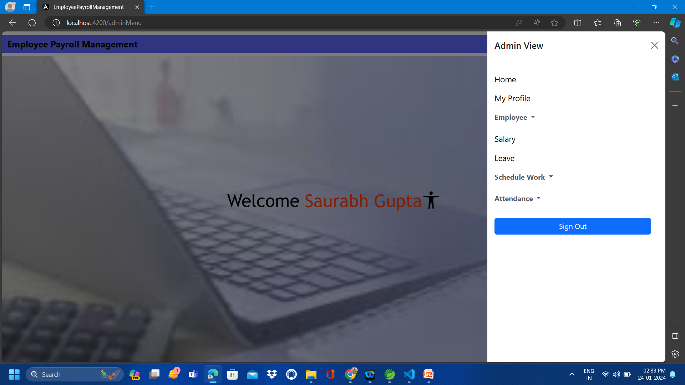
Admin Page:

Slide 17
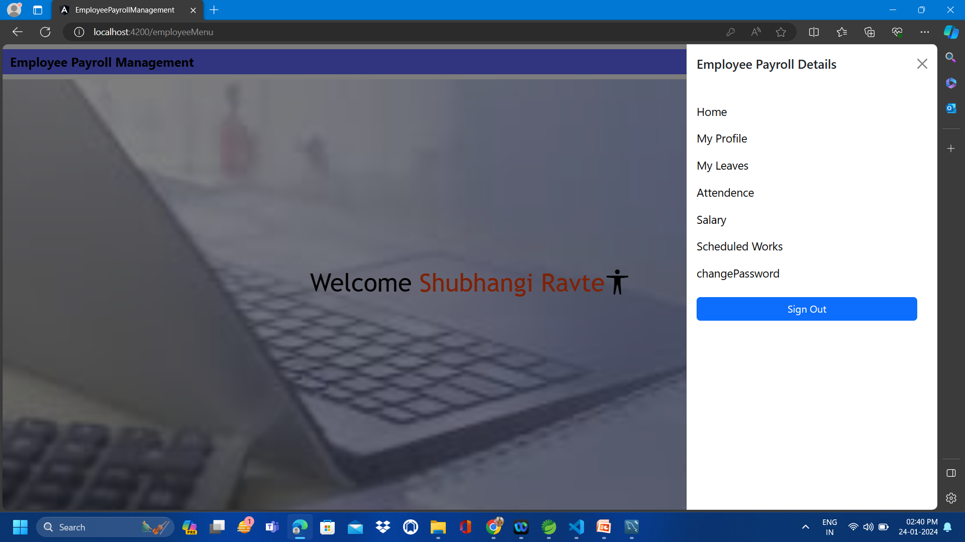
Employee Page:

Slide 18

Update Profile
Update profile :The admin and employee can view and update the profile.

Slide 19
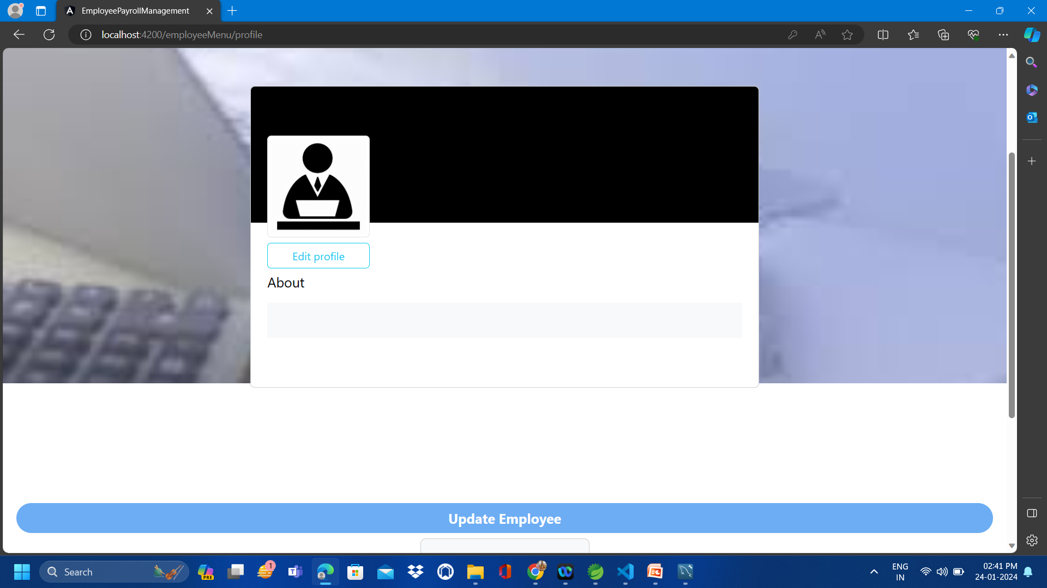
Screenshot of Updating Profile

Slide 20
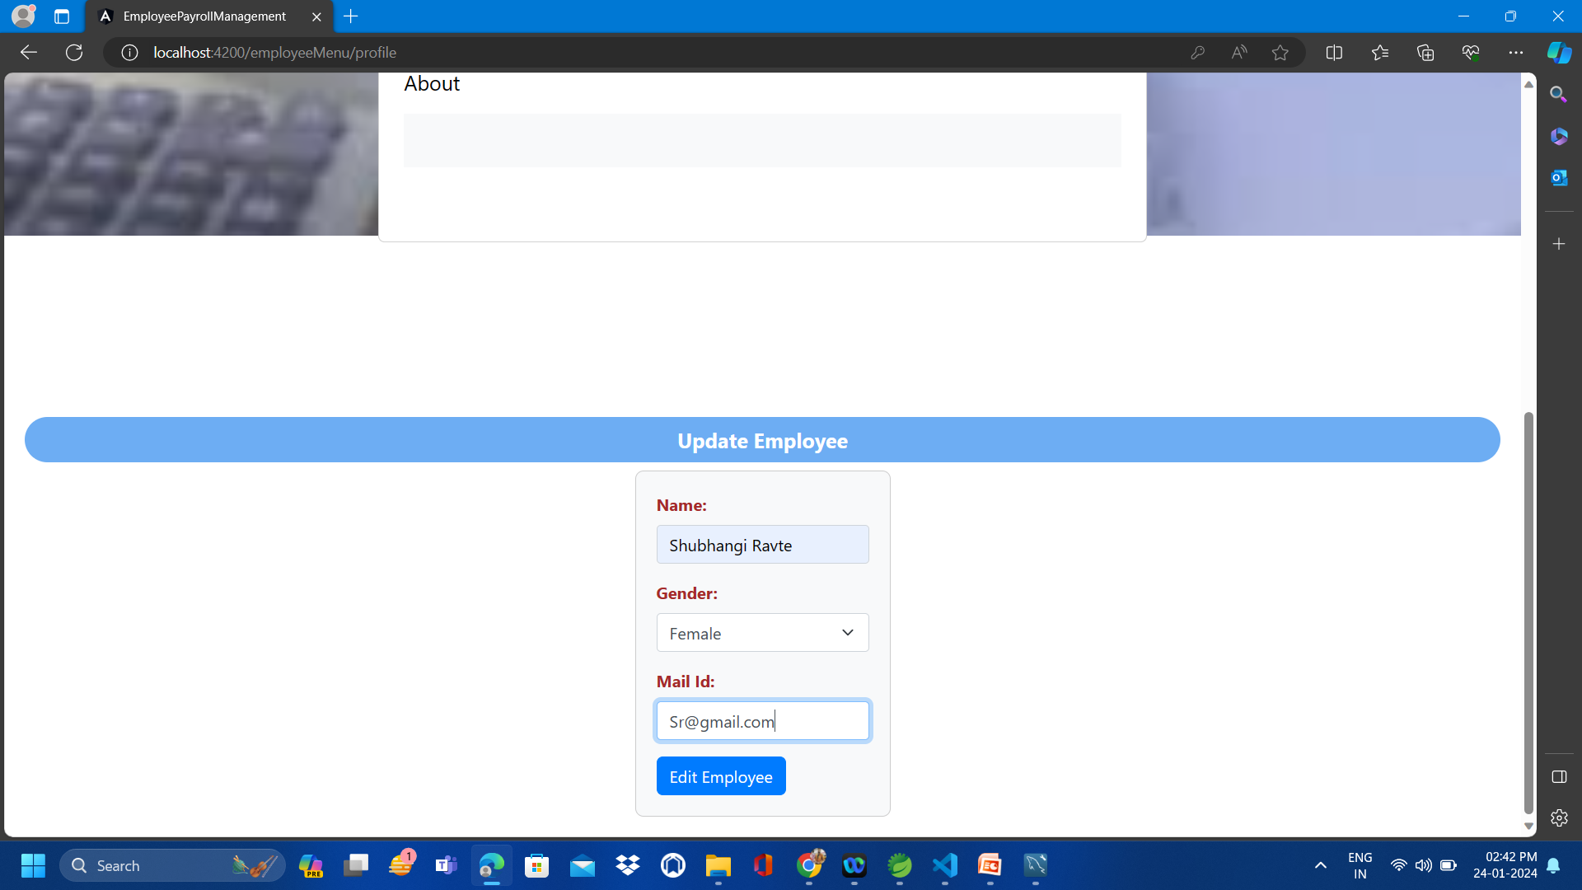
Screenshot of Updating Profile

Slide 21

Adding and Viewing Employees
Add : Growing your team... Onboarding new members is a simple process—just provide the necessary details.
View : You can also view your workforce enhanced organization and efficient management.

Slide 22
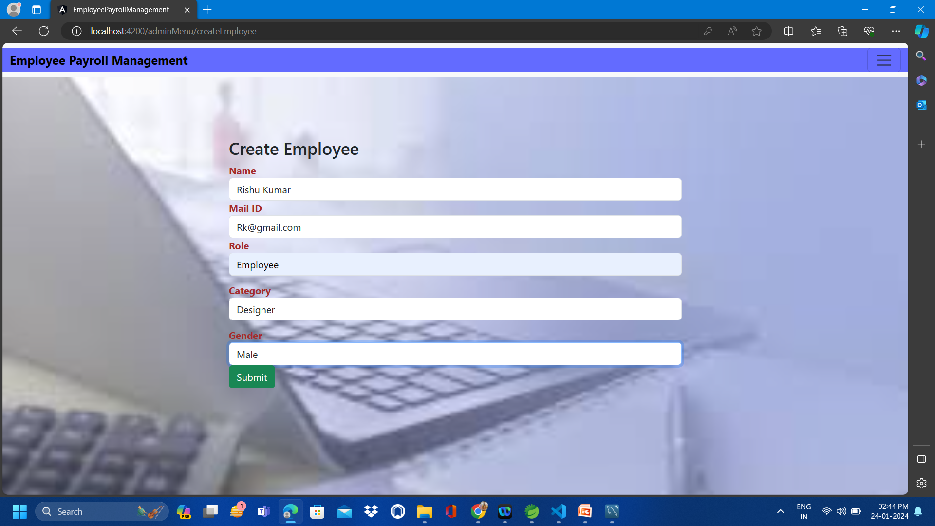
Screenshot for Adding Employees

Slide 23
Editing and Deleting Employees
Edit : You can effortlessly update employee details to align with their current responsibilities.
Delete : eliminating employee records is a hassle-free process, maintaining precision in your records.

Slide 24
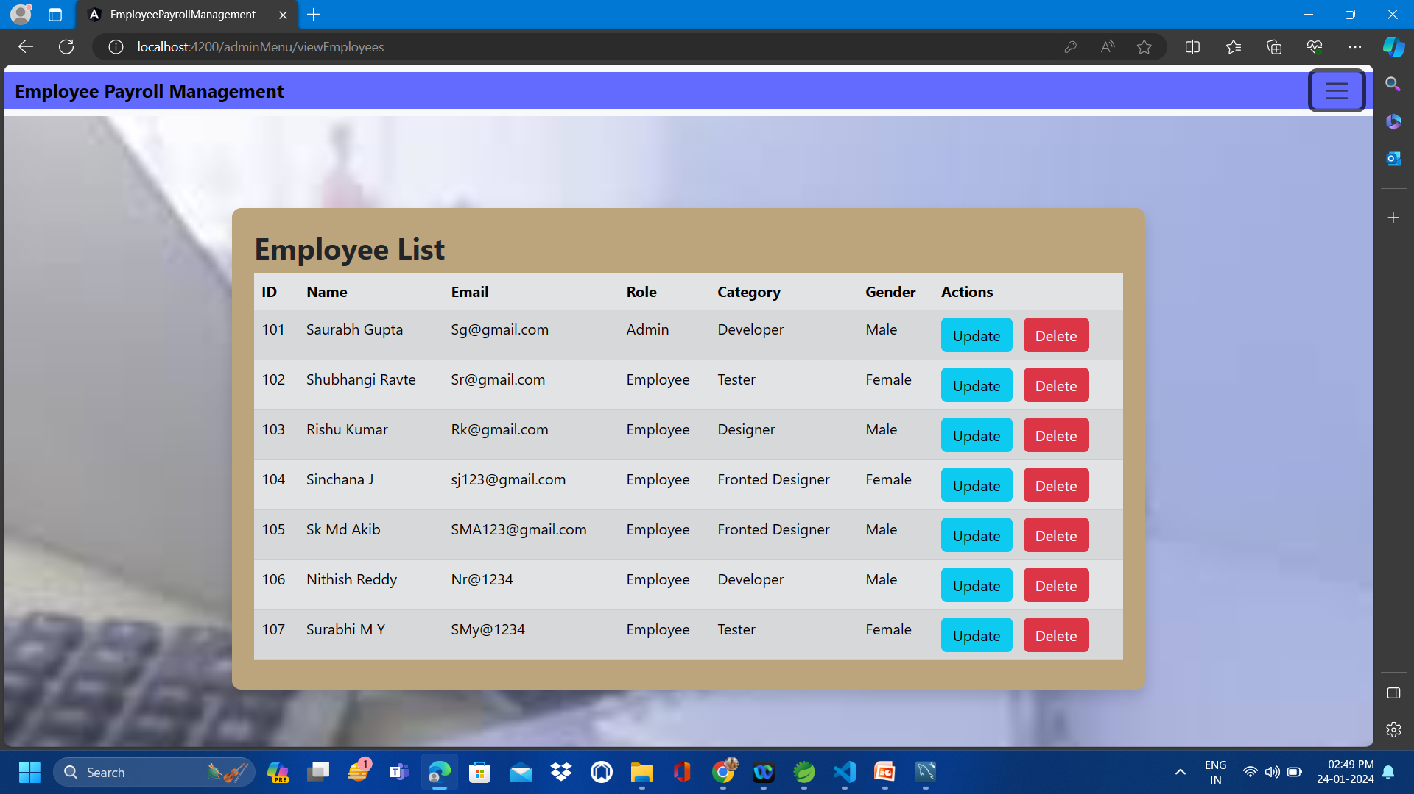
Screenshot for Edit/Delete Employees

Slide 25

Add/Edit/Delete Schedule work of Employees
Effortlessly add, update, or remove schedules as necessary, promoting smooth operations.
Obtain a comprehensive perspective on work schedules, facilitating optimal coordination.

Slide 26
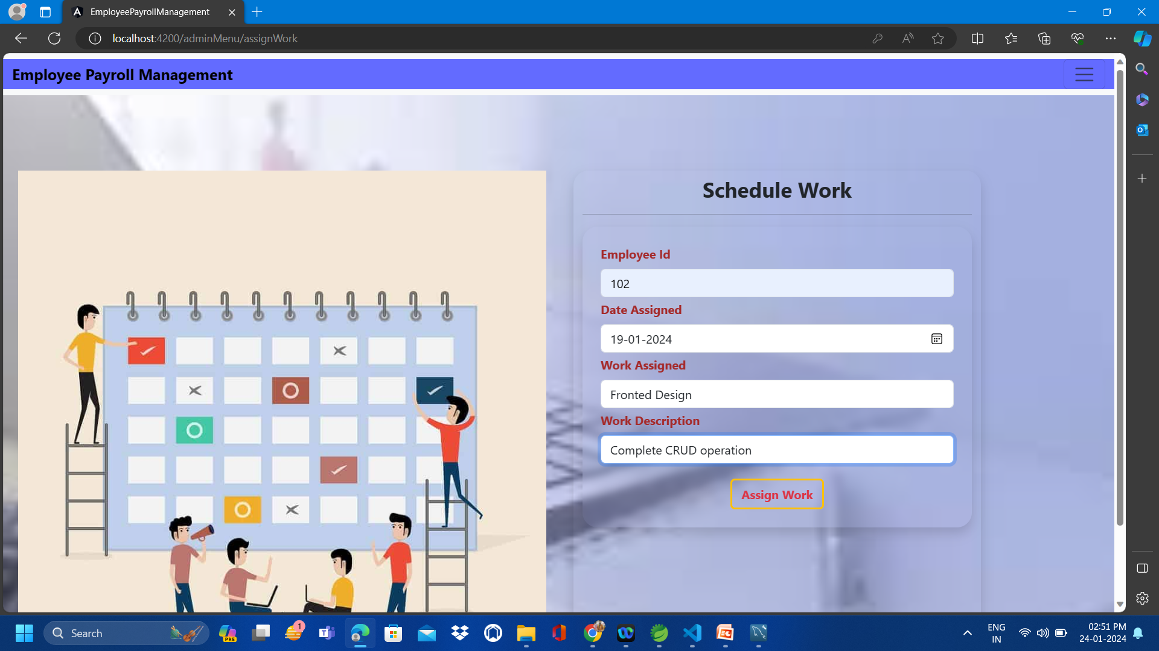
Screenshot for EDITING Schedule work

Slide 27
View Schedule work of Employees
Optimize the handling of employee schedules through our user-friendly system.
Simplify workforce management and elevate productivity with ease.

Slide 28
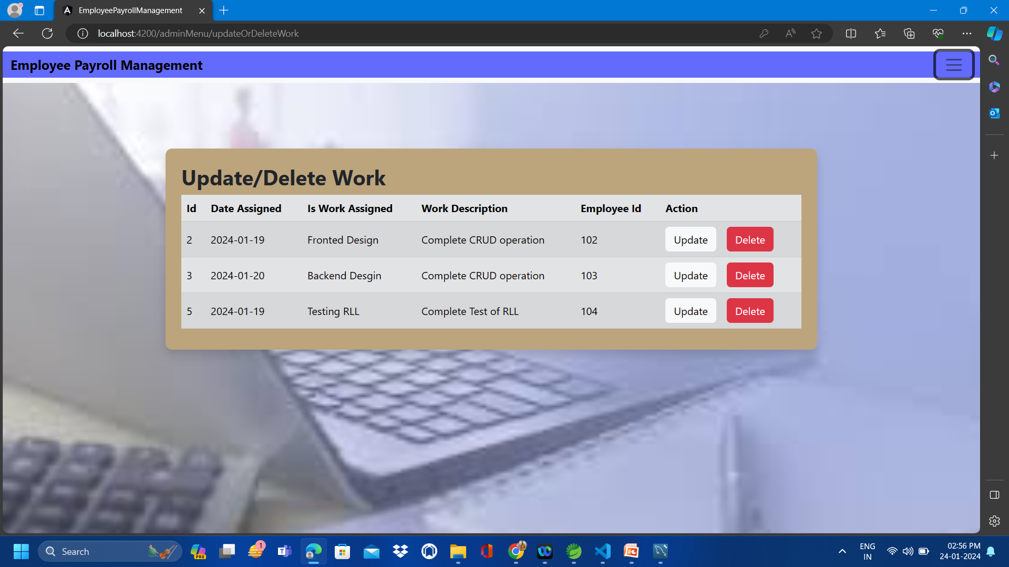
Screenshot for UPDATING & DELETING Schedule work

Slide 29

Add, Edit and Delete Leaves of Employees
Add: Recording leave details for employees is simple. Just enter the dates and reasons, and you're good to go!
Edit: Making adjustments to leave dates? No worries! Effortlessly edit leave records to align with new plans.
Delete: Plans shifted? Deleting leave entries is easy, maintaining precise and up-to-date records.

Slide 30
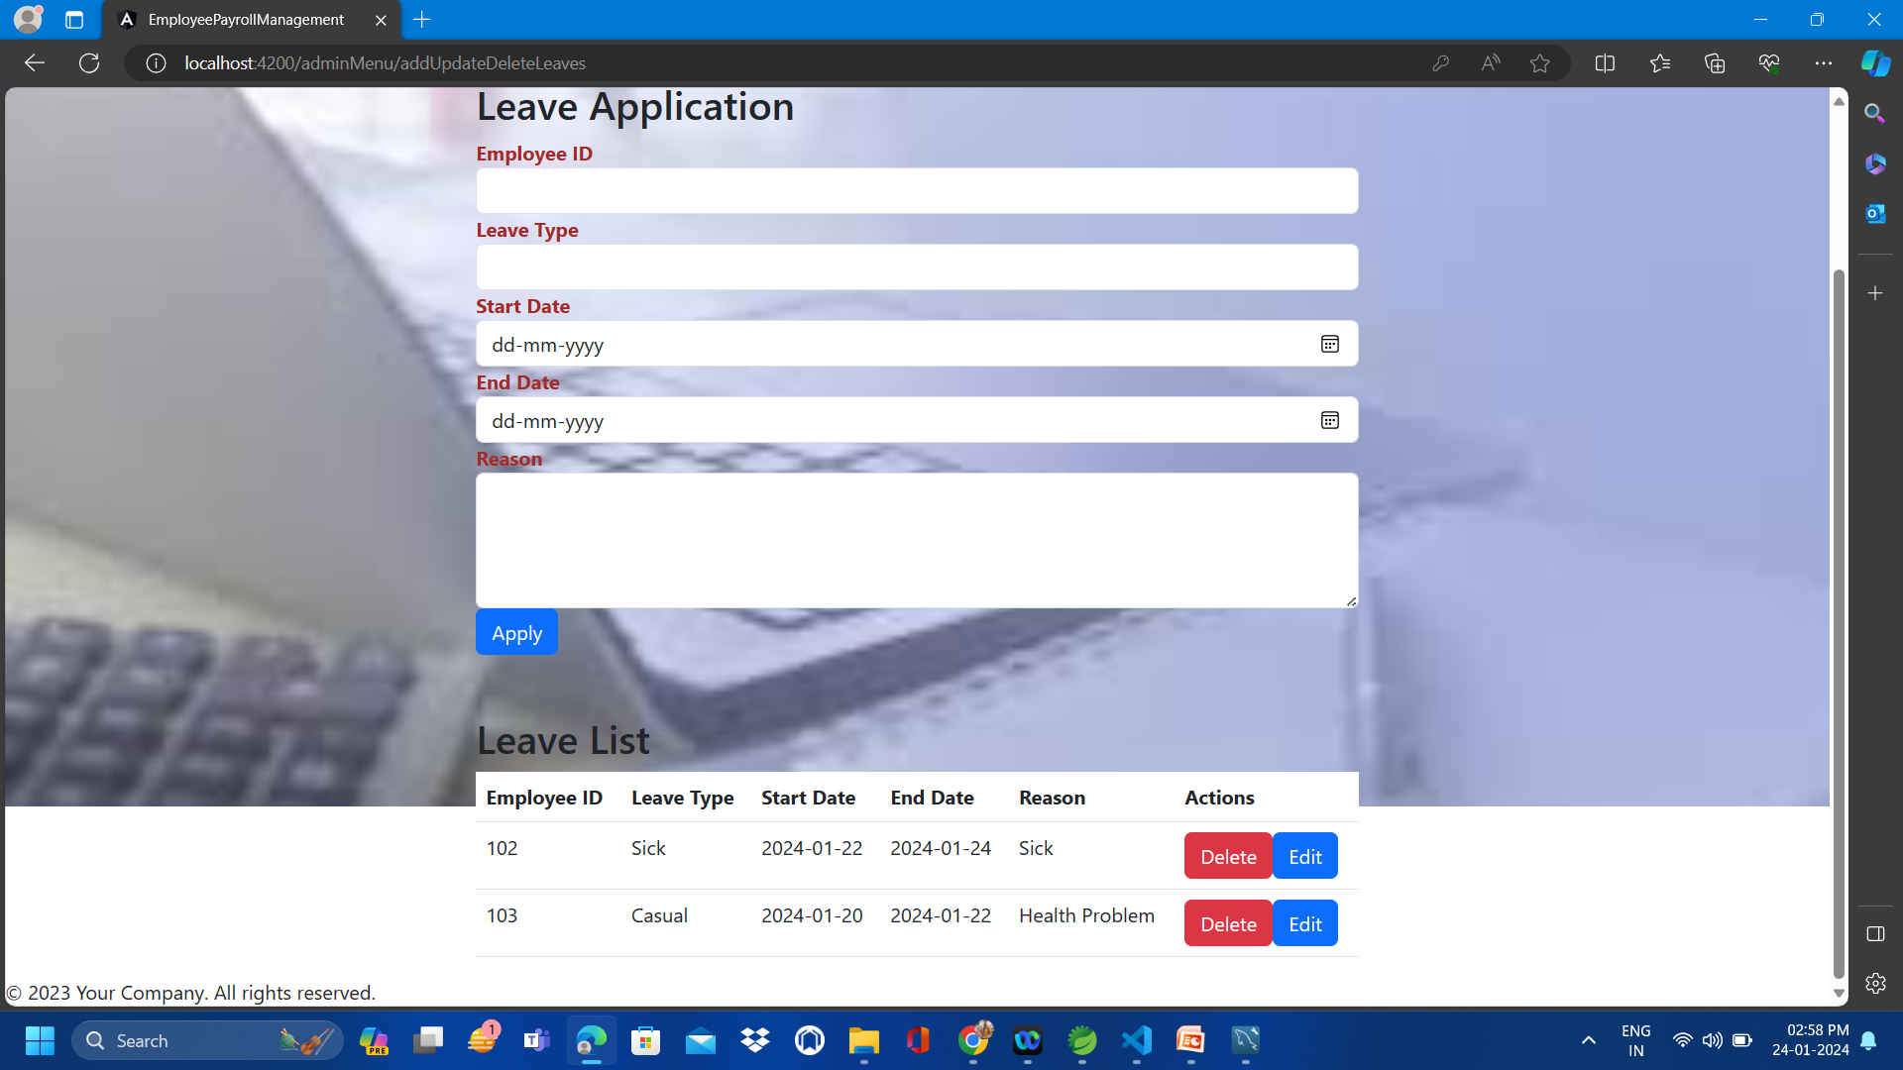
Screenshot for Edit and Delete Leaves OF EMPLOYEE

Slide 31
View Leaves of Employees
View: Obtain a swift summary of employees on leave and their schedules. Stay organized and plan effectively for the future.

Slide 32
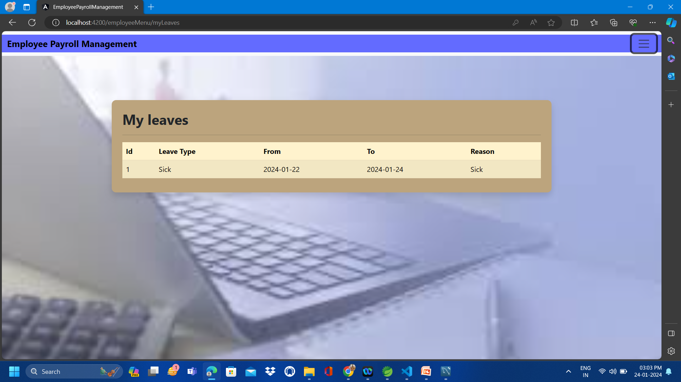
Screenshot for View Leaves

Slide 33

Add/Edit/Delete Attendance of Employees
Add : Capturing employee attendance is effortless. Simply enter the dates they worked, and you're all set!
Edit: Made an error in the attendance log? Not an issue! Easily revise attendance records to reflect the accurate hours.
Delete: Circumstances evolving? You can delete attendance entries without any difficulty, ensuring precise record-keeping.

Slide 34
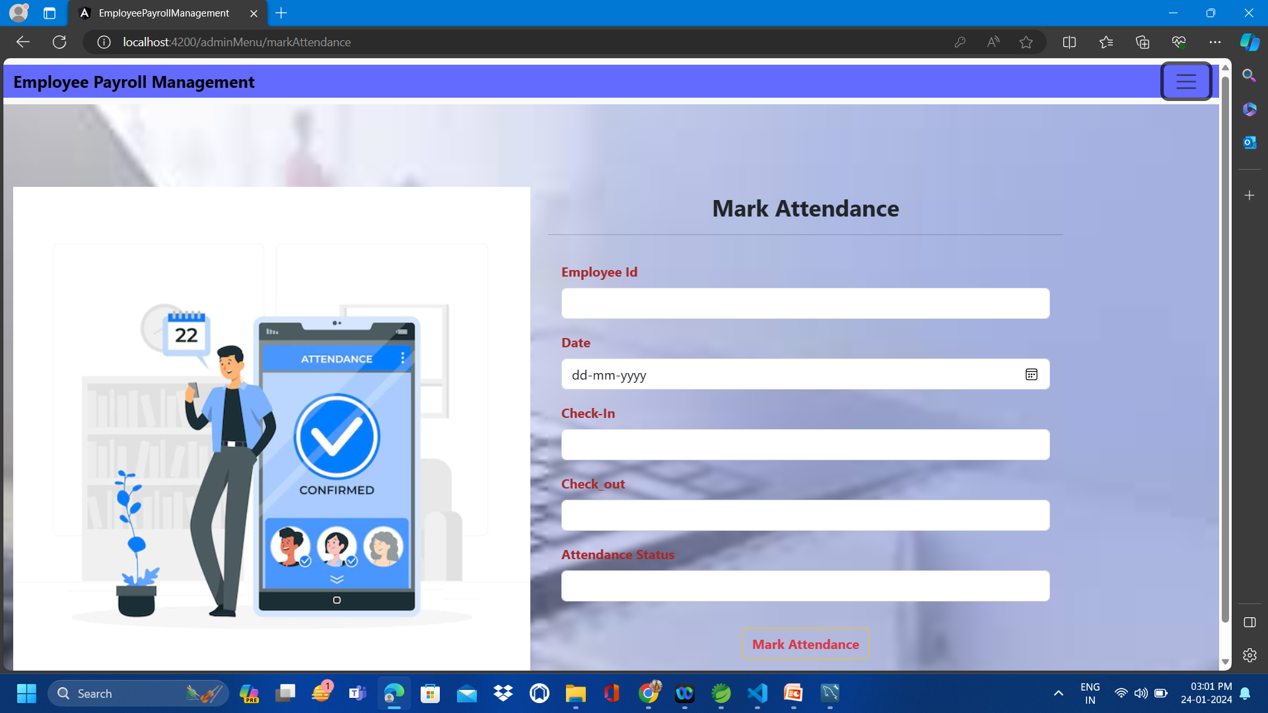
ADD Attendance of Employees

Slide 35
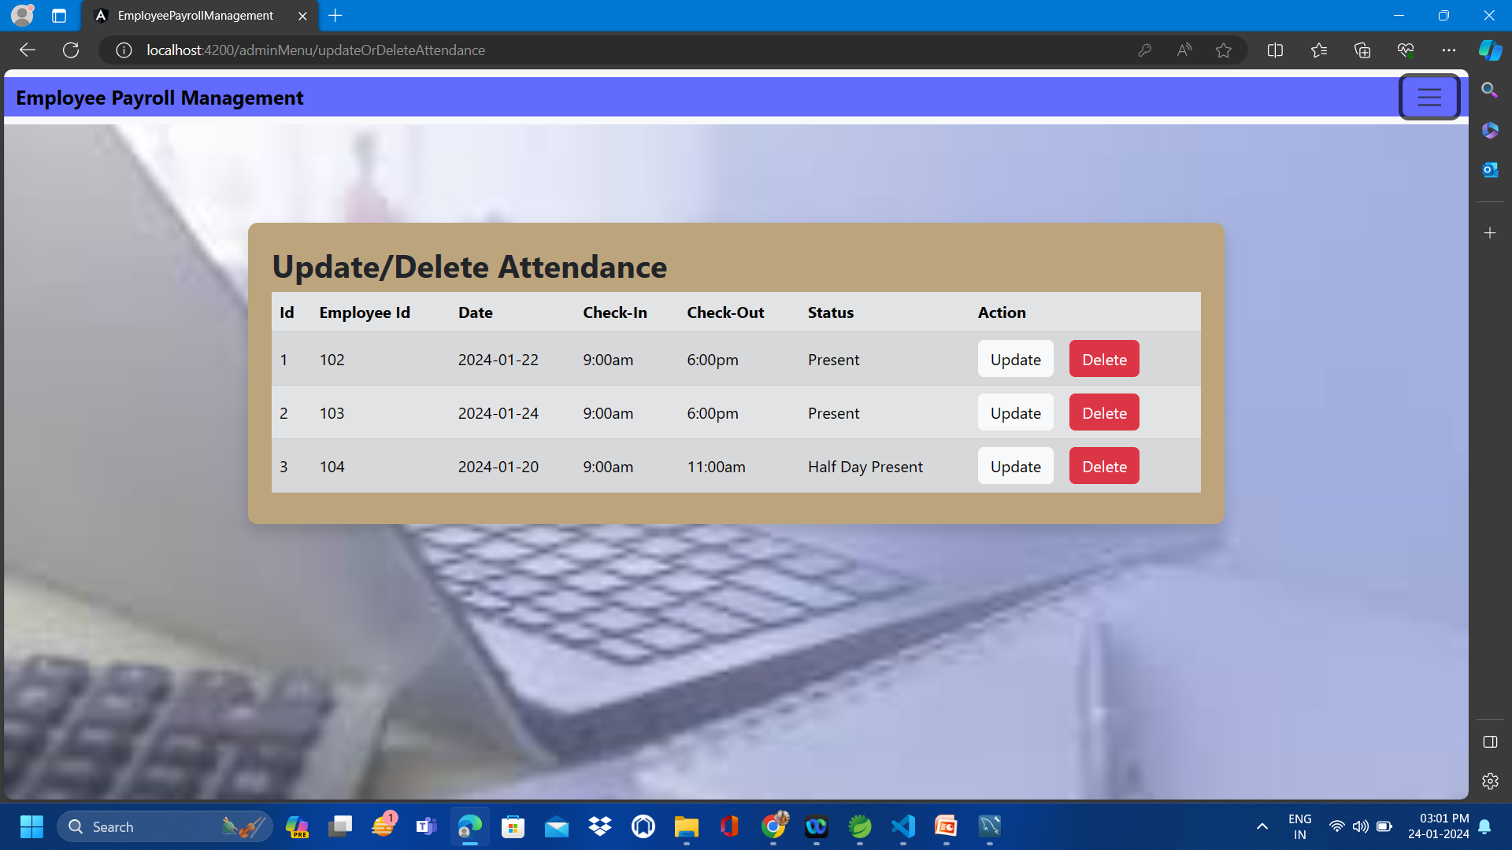
Screenshot for UPDATE/Delete Attendance

Slide 36

View attendance of Employees
View: Need to know who was present and when? Get a quick snapshot of attendance to stay organized and plan effectively

Slide 37
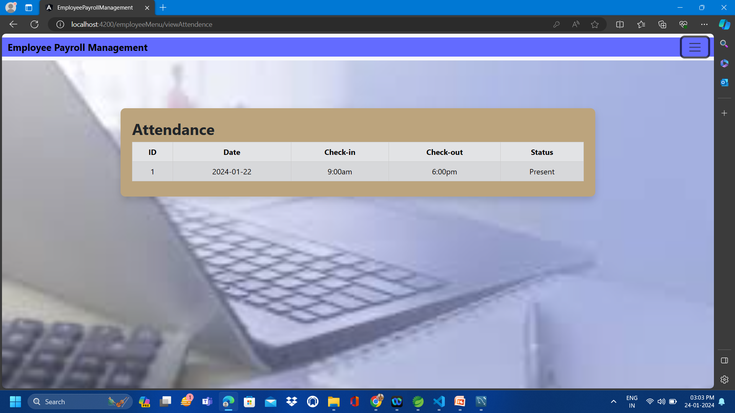
Screenshot for View Attendance

Slide 38

Add/Edit/Delete Salary of Employees
Add: Handling employee salaries is straightforward. Just input the details, and you're ready to go!
Edit: Require adjustments to salary figures? No problem! Easily modify salary records as necessary.
Delete: Circumstances evolving? You can delete salary entries without any hassle, maintaining accurate records.

Slide 39
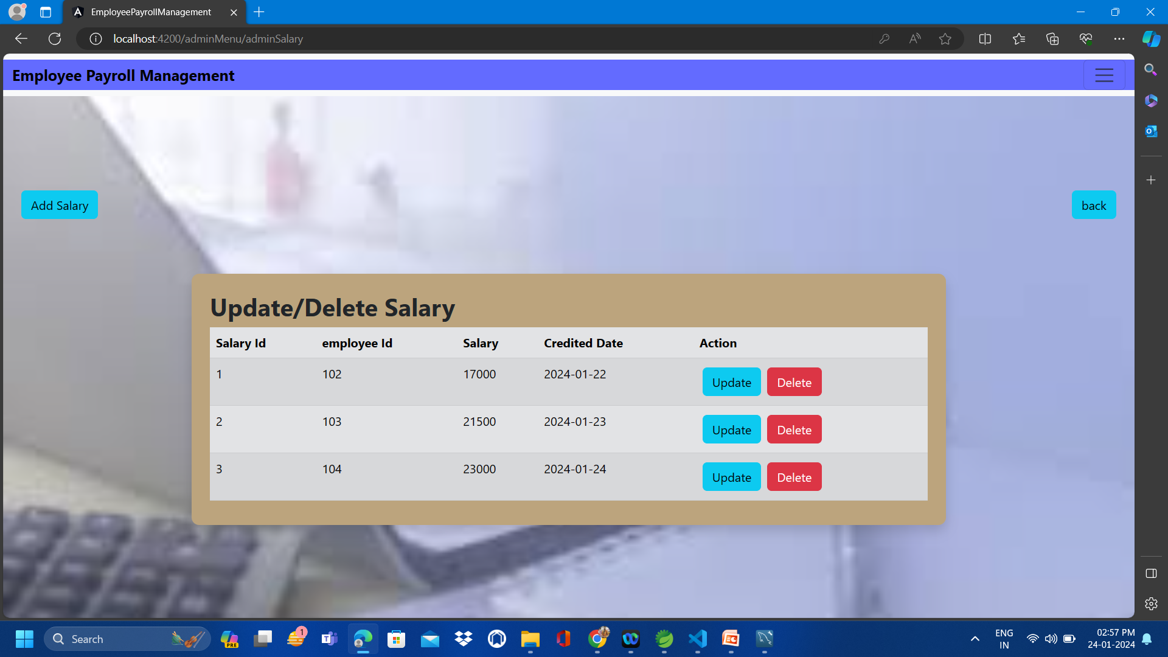
Screenshot for UPDATE/delete Salary

Slide 40
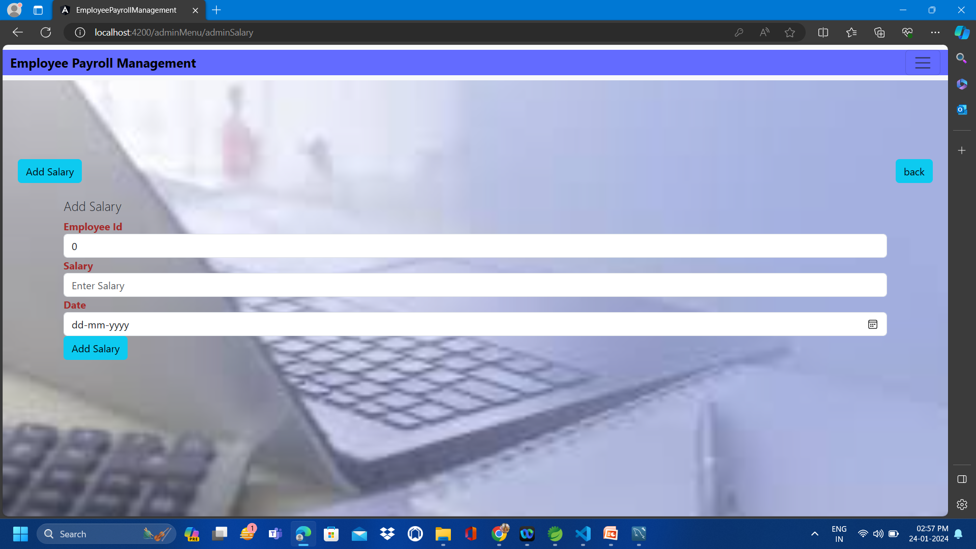
Screenshot for ADD Salary

Slide 41

View and Download Salary slips of Employees
View: Reviewing your salary details is trouble-free. With just a click, you can access and see your earnings.
Download: Require a copy? You can download your salary slip whenever needed.

Slide 42
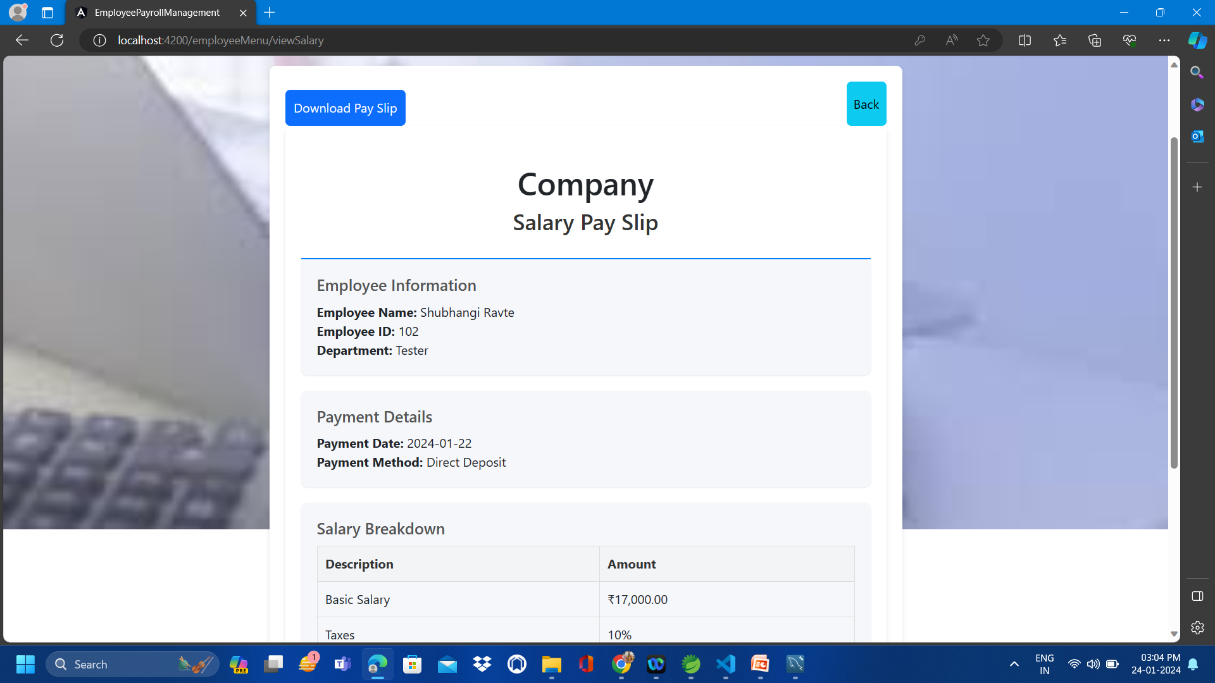
Screenshot for View and Download Salary Slip

Slide 43
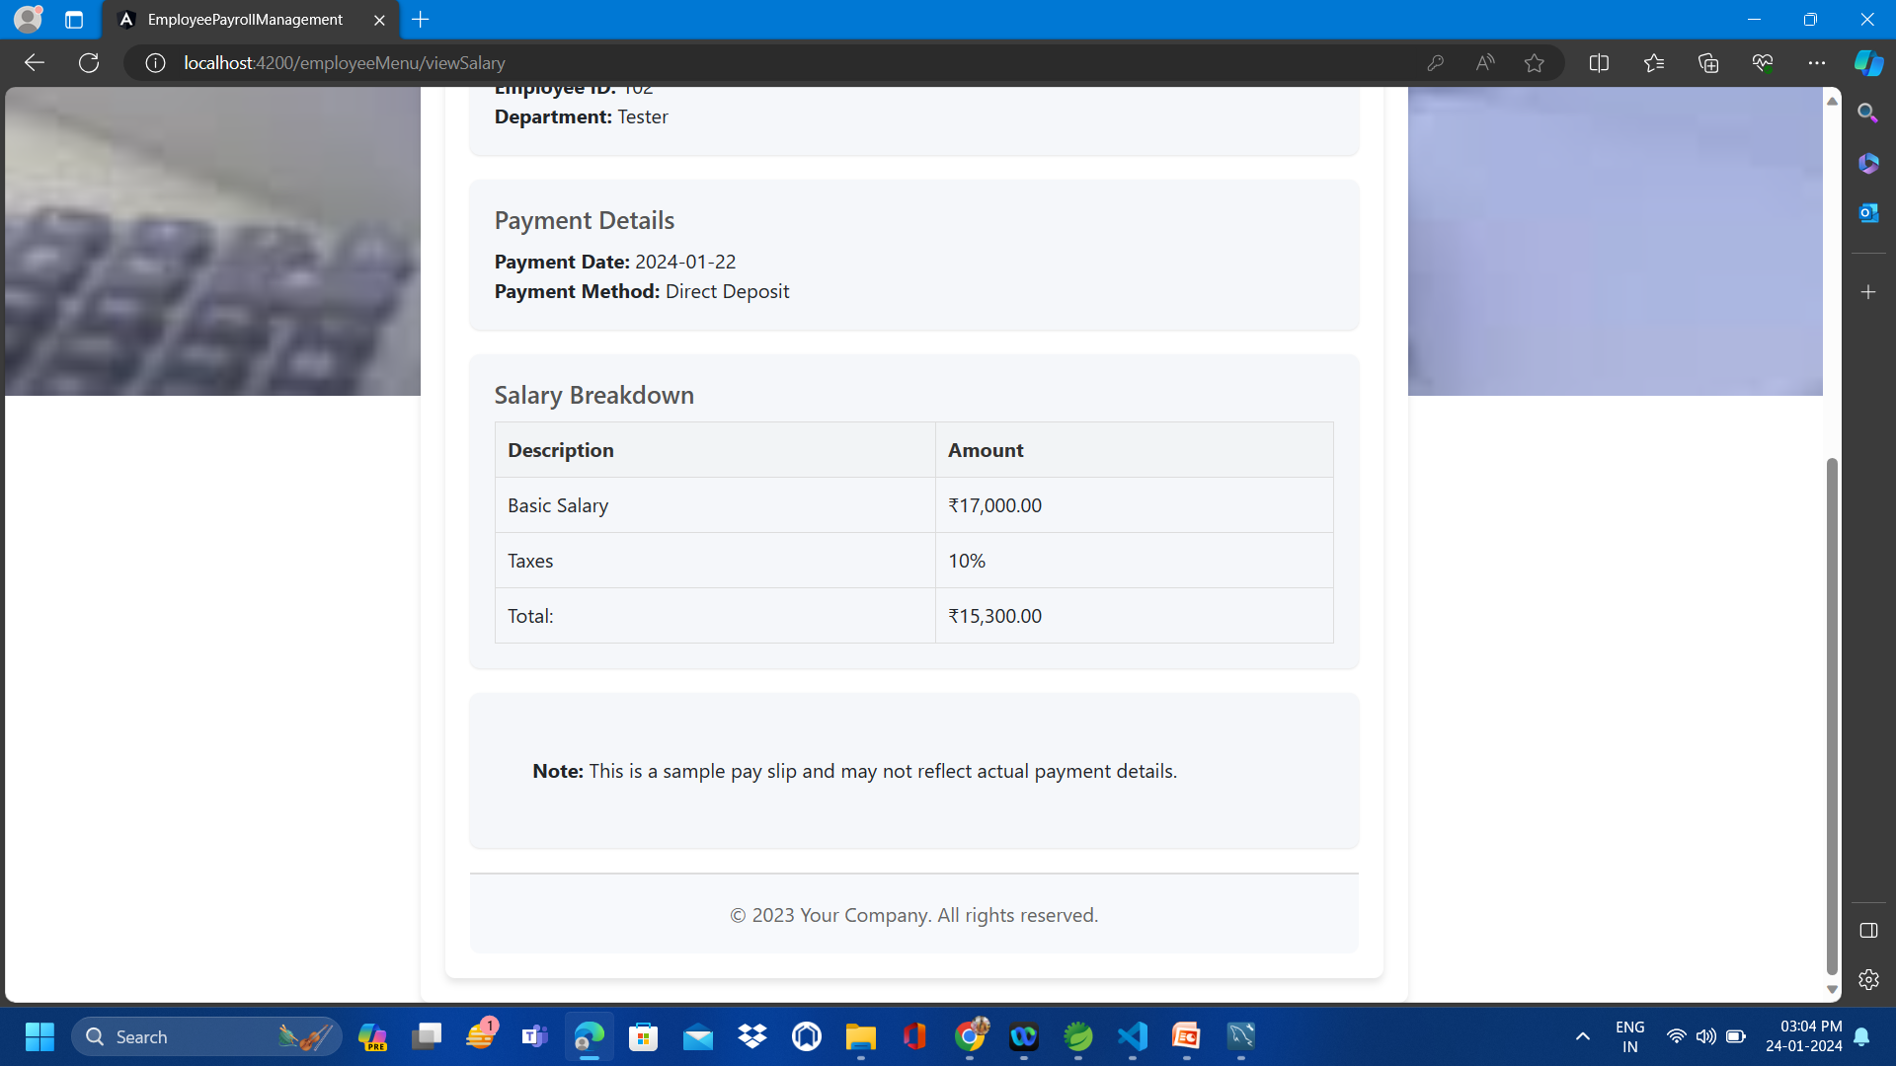
Screenshot for View and Download Salary Slip

Slide 44
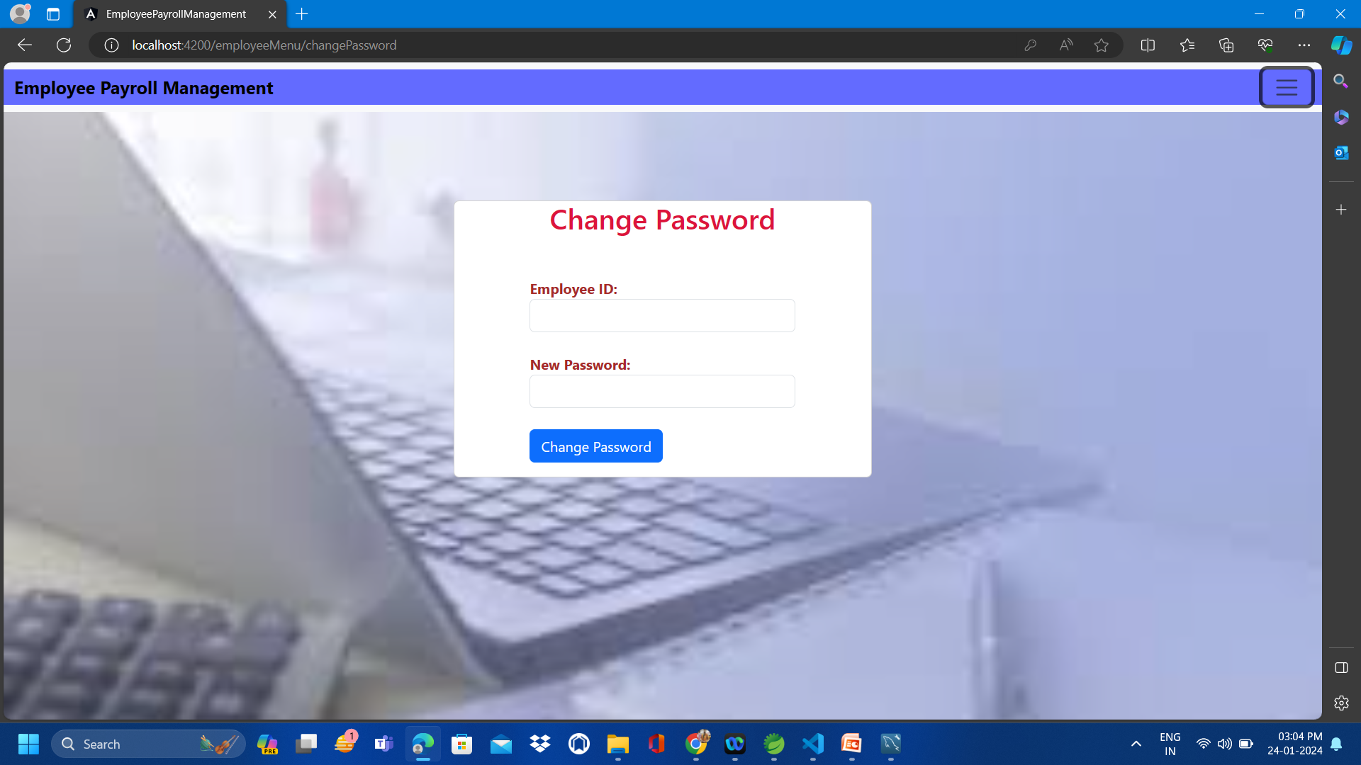
Change Password page

Slide 45
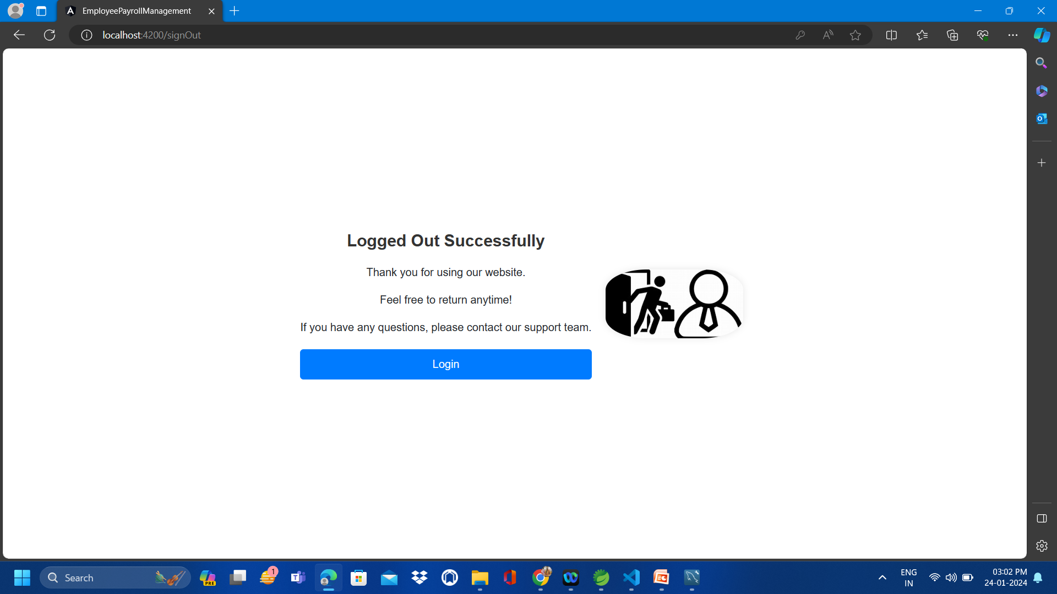
Logout page:

Slide 46
Conclusion
Tailored for small organizations, our project caters to both admins and employees, particularly suitable for workplaces with a limited team. Admins wield the authority to add, update, and remove employee information, manage new hires, and set Salaries.
Accessible records and monthly payments contribute to the project's goal of simplifying processes, saving time, cutting costs, and ensuring effective record management for smooth operations.

Slide 47


